Slide 1
SMART BODY POSTURE RECOGNITION AND GUIDING SYSTEM
PEER MEMBERS: ACADEMIC GUIDE:
•ANTONY RAJ.M(15ITA01) Mr.RAJASEKARAN.S (AP/IT)
•MANOJ.M(15ITA11) INDUSTRY GUIDE:
•PADMAJAA.B(15ITA17) Mr.HARI BALAKUMARAN

Slide 2
PROBLEM STATEMENT
To capture the hand gesture and check whether the hand is placed in the right gesture using image processing system.If the hand is in wrong gesture then arriving at accurate results are not possible.This problem is solved using smart body posture recognition.

Slide 3
ABSTRACT:
A gesture is a form of nonverbal communication or non vocal communication. Gestures include movement of the hands, face, or other parts of the body. Gestures allow individuals to communicate a variety of feelings and thoughts. Gesture processing takes place in areas of the brain such as Broca's and Wernicke's areas, which are used by speech and sign language. We provide a system that captures the image of the whole body and it recognizes the body posture of an individual and gives them the right posture for calculating the blood pressure through image processing.

Slide 4
LITERATURE SURVEY
Survey on various gesture recognition techniques and technologies
Author: Noor Adnan Ibraheem , RafiqulZaman Khan
Paper: International Journal
Published in: 2012
Gestures considered as the most natural expressive way for communications between human and computers in virtual system. Hand gesture is a method of non-verbal communication for human beings for its freer expressions much more other than body parts.

Slide 5
LITERATURE SURVEY (CONTD)
Survey on hand gesture recognition in context of soft computing
Authors: Ankit chaudhary, J.L. Raheja, Karen Das and Sonia Raheja
Paper: Conference
Published in: 2010
In this paper we are discussing work done in the area of hand gesture recognition where focus is on the soft computing based methods like artificial neural network, fuzzy logic, genetic algorithms, etc. We also de-scribed hand detection methods in the preprocessed image for detecting the hand image.

Slide 6
MODULES:
Posture Module
Result Module

Slide 7
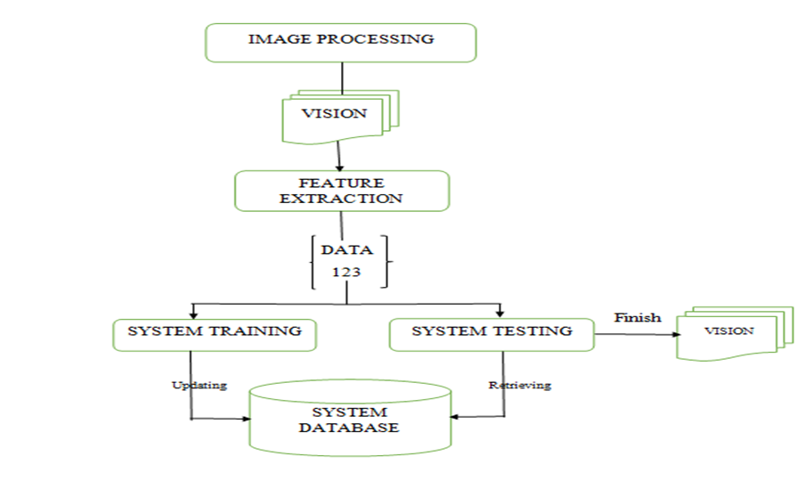
ARCHITECTURE DIAGRAM:

Slide 8
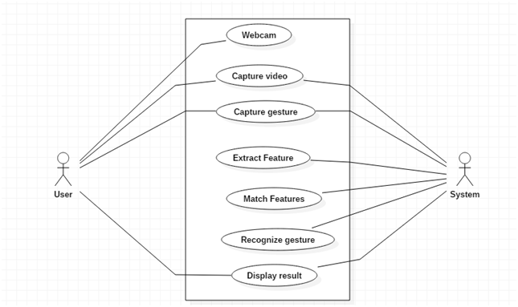
USE CASE DIAGRAM:

Slide 9
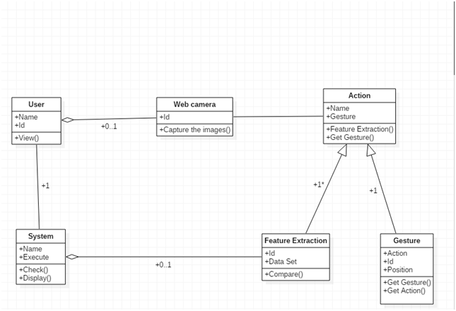
CLASS DIAGRAM:

Slide 10
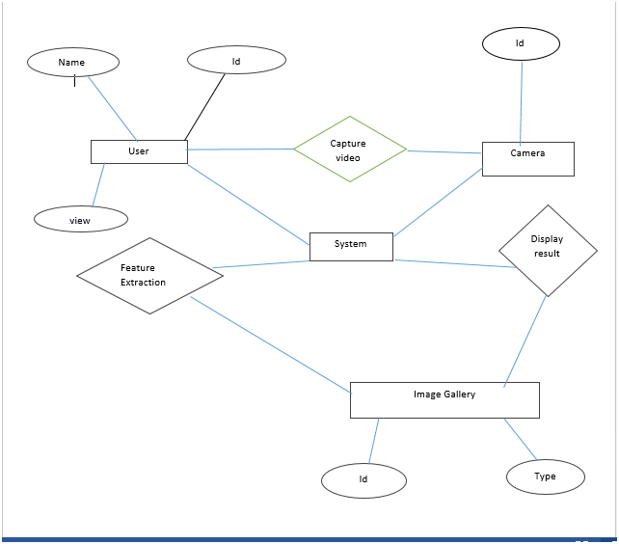
ER DIAGRAM:

Slide 11
REQUIREMENT ANALYSIS FOR EACH MODULE:
●Posture module:
○Checking gesture.
●Result module:
○Display the result to user.

Slide 12
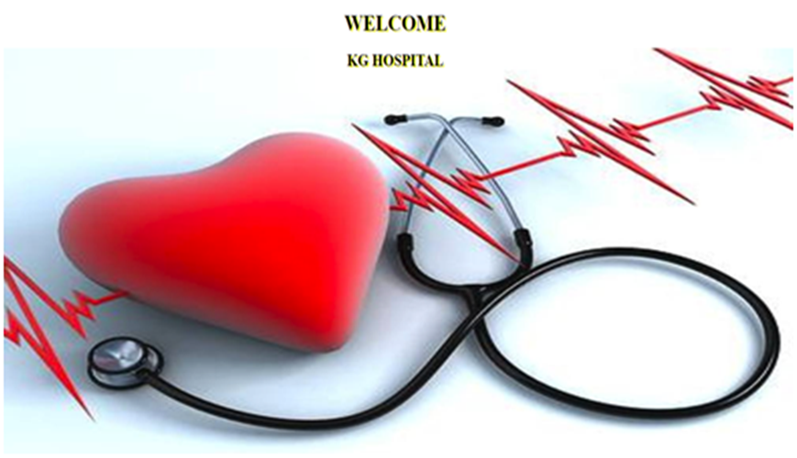
INTERFACE:

Slide 13
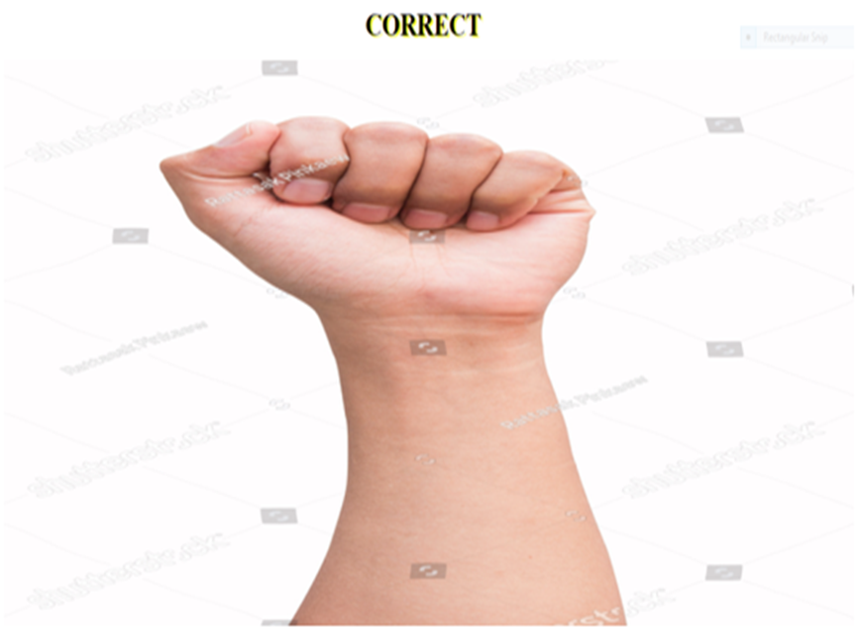

Slide 14
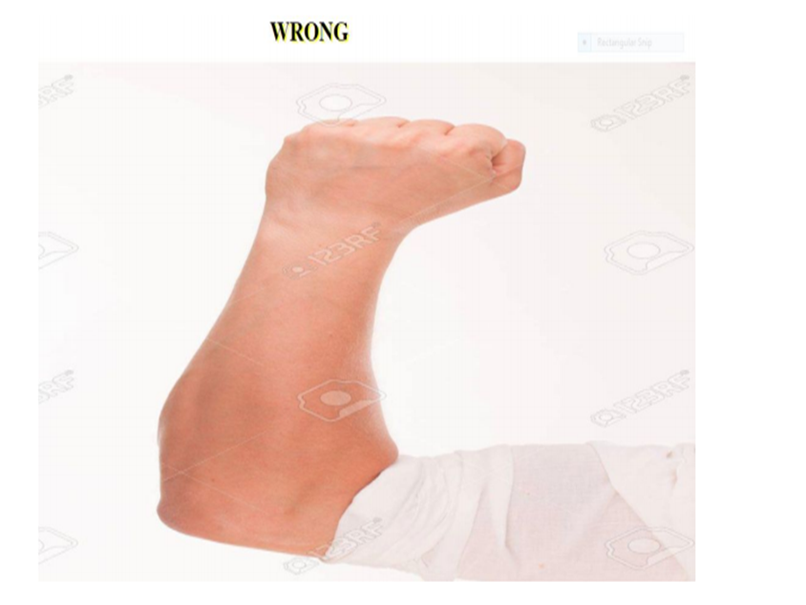

Slide 15
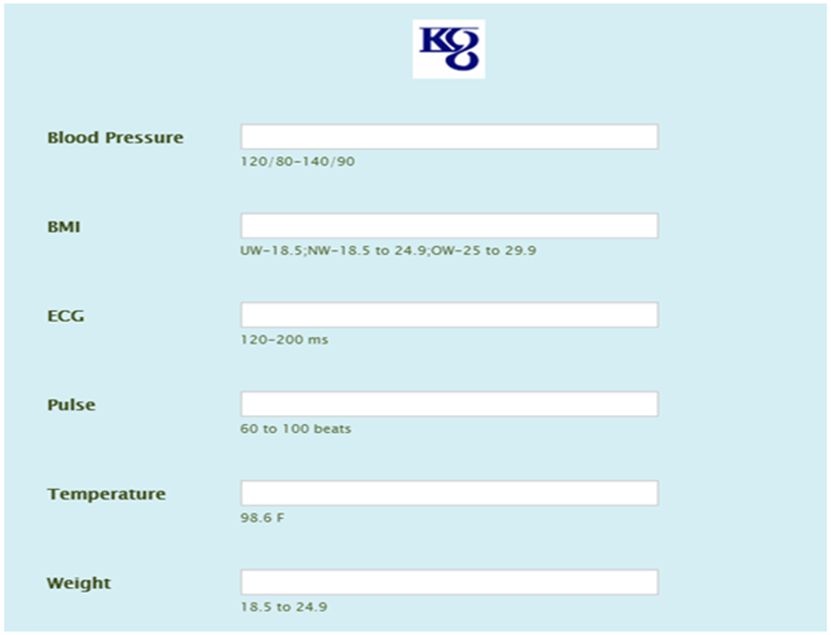

Slide 16
TESTING PLANS:
The project will be implemented in small level in the clinics.
It’ll check the posture of the patient’s hands and correct them if its wrong.
The usability and effectiveness of the project is taken as feedback from the doctors who have installed the system.

Slide 17
CODING FOR INITIALIZING THE CAMERA FOR CAPTURING THE IMAGES OF HAND

Slide 18
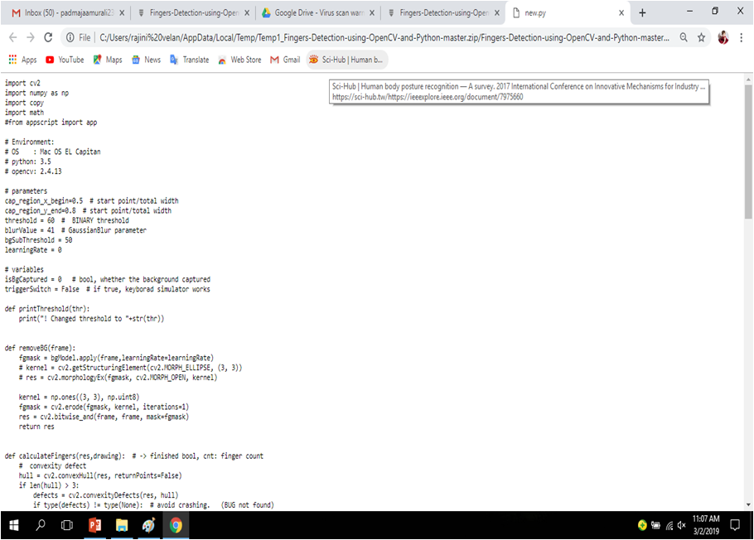

Slide 19
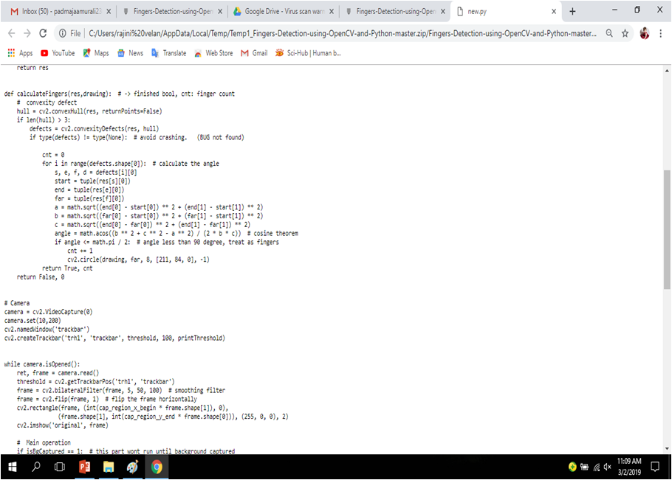

Slide 20
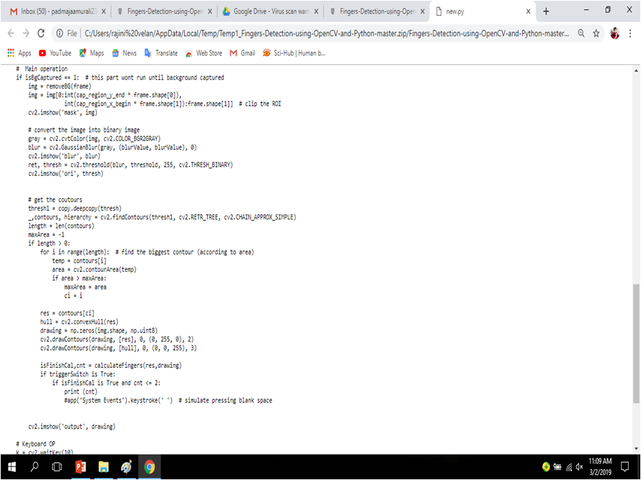

Slide 21
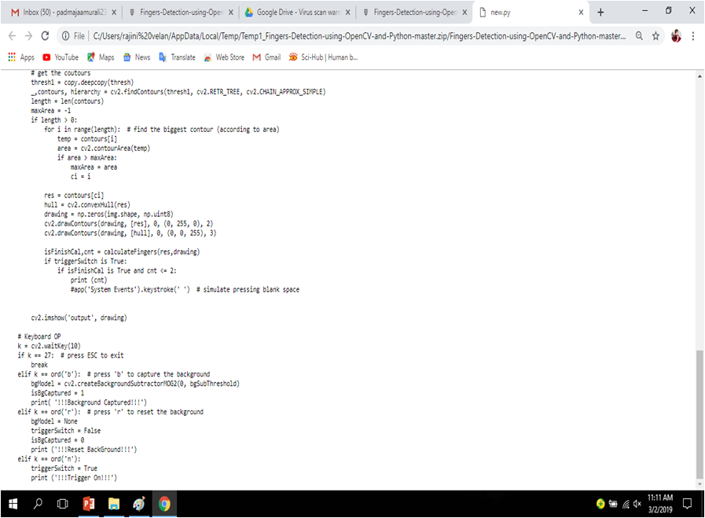

Slide 22
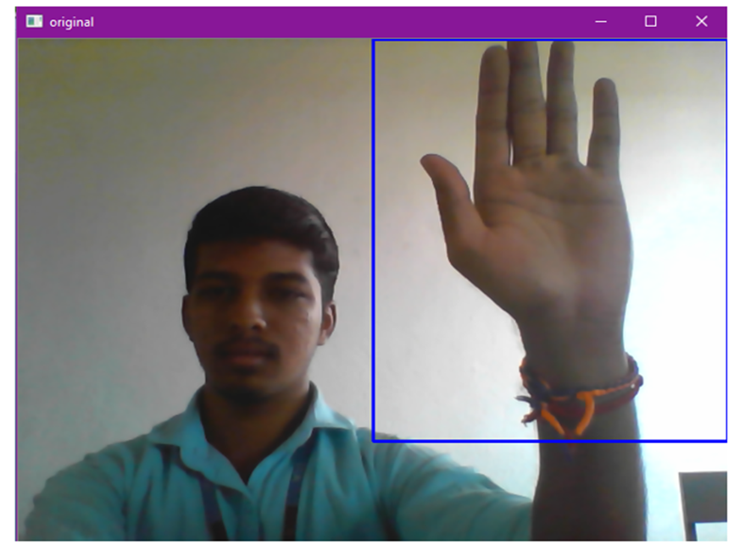

Slide 23
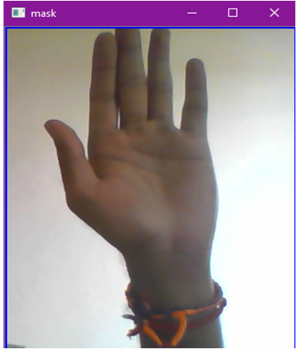
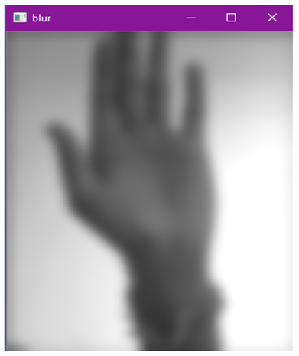

Slide 24
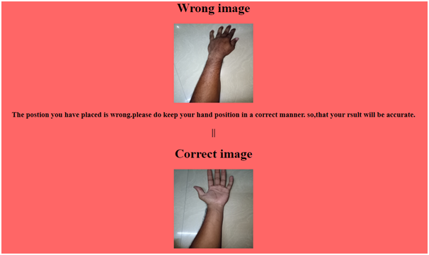

Slide 25
CONCLUSION:
Thus,these modules are user friendly for the users and guide them for having the correct gesture so that the medical diagnosis becomes easier.

Slide 26
QUESTIONS?

Slide 27
THANK YOU

